Slide 1
Unity & Arduino
Setup Guide

Slide 2
Overview
Ensure you have the following on your device:
Unity
Ardity package
Arduino / Arduino IDE
A code editor/IDE e.g. Visual Studio Code (to edit code accordingly

Slide 3
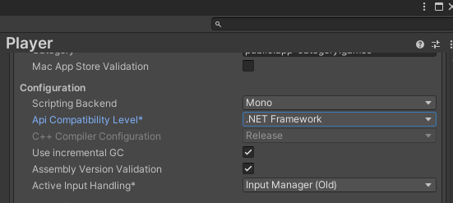
Setting Up Unity
Create a new 3D project
Go to File > Build Settings > Player Settings
Configurations>API Compatibility Level
Change from .NET 2X to .NET 4X or any other option

Slide 4
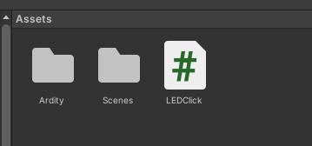
Setting up Ardity
Install the package from https://ardity.dwilches.com/
In Unity, go to Assets > Import Package > Custom Package…
Select the Ardity package
Ardity should appear in your Assets

Slide 5
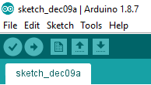
Setting Up Arduino / Arduino IDE
Go to Tools:
Set the board to Arduino Uno (or the board type you are using
Set the Port to the one connected to Arduino (Usually the one other than COM3/4)

